Slide 1
Kotlin Exception Handling

Slide 2
Exception is a runtime problem which occurs in the program and leads to program termination. This may be occur due to running out of memory space, array out of bond, condition like divided by zero. To handle this type of problem during program execution the technique of exception handling is used.
Exception handling is a technique which handles the runtime problems and maintains the flow of program execution.

Slide 3
There are four different keywords used in exception handling. These are:
try
catch
finally
throw
try: try block contains set of statements which might generate an exception. It must be followed by either catch or finally or both.
catch: catch block is used to catch the exception thrown from try block.
finally: finally block always execute whether exception is handled or not. So it is used to execute important code statement.
throw: throw keyword is used to throw an exception explicitly.

Slide 4
Kotlin Unchecked Exception
Unchecked exception is that exception which is thrown due to mistakes in our code. This exception type extends RuntimeException class. The Unchecked exception is checked at run time. Following are some example of unchecked exception:
ArithmeticException: thrown when we divide a number by zero.
ArrayIndexOutOfBoundExceptions: thrown when an array has been tried to access with incorrect index value.
SecurityException: thrown by the security manager to indicate a security violation.
NullPointerException: thrown when invoking a method or property on a null object.

Slide 5
Problem without Exception Handling
fun main(args: Array<String>){
val data = 20 / 0 //may throw exception
println("code below exception ...")
}

Slide 6
fun main(args: Array<String>){
try {
val data = 20 / 0 //may throw exception
} catch (e: ArithmeticException) {
println(e)
}
println("code below exception...")
}

Slide 7
Kotlin try as an expression example
fun main(args: Array<String>){
val str = getNumber("10")
println(str)
}
fun getNumber(str: String): Int{
return try {
Integer.parseInt(str)
} catch (e: ArithmeticException) {
0
}
}

Slide 8
fun main(args: Array<String>){
val str = getNumber("10.5")
println(str)
}
fun getNumber(str: String): Int{
return try {
Integer.parseInt(str)
} catch (e: NumberFormatException) {
0
}
}

Slide 9
Kotlin Multiple catch Block
fun main(args: Array<String>){
try {
val a = IntArray(5)
a[5] = 10 / 0
} catch (e: ArithmeticException) {
println("arithmetic exception catch")
} catch (e: ArrayIndexOutOfBoundsException) {
println("array index outofbounds exception")
} catch (e: Exception) {
println("parent exception class")
}
println("code after try catch...")
}

Slide 10
What happen when we catch from general exception to specific exception?
fun main(args: Array<String>){
try {
val a = IntArray(5)
a[5] = 10 / 0
}
catch (e: Exception) {
println("parent exception catch")
}
catch (e: ArithmeticException) {
println("arithmetic exception catch")
} catch (e: ArrayIndexOutOfBoundsException) {
println("array index outofbounds exception")
}
println("code after try catch...")
}

Slide 11
Kotlin Nested try-catch block
fun main(args: Array<String>) {
val nume = intArrayOf(4, 8, 16, 32, 64, 128, 256, 512)
val deno = intArrayOf(2, 0, 4, 4, 0, 8)
try {
for (i in nume.indices) {
try {
println(nume[i].toString() + " / " + deno[i] + " is " + nume[i] / deno[i])
} catch (exc: ArithmeticException) {
println("Can't divided by Zero!")
}
}
} catch (exc: ArrayIndexOutOfBoundsException) {
println("Element not found.")
}
}

Slide 12
Kotlin finally Block
fun main (args: Array<String>){
try {
val data = 10 / 5
println(data)
} catch (e: NullPointerException) {
println(e)
} finally {
println("finally block always executes")
}
println("below codes...")
}

Slide 13
Derived Class Initialization Order
When we create an object of a derived class then constructor initialization starts from the base class. Which means first of all base class properties will be initialized, after that any derived class instructor will be called and same applies to any further derived classes.
This means that when the base class constructor is executed, the properties declared or overridden in the derived class have not yet been initialized.

Slide 14
Derived Class Initialization Order
open class Base {
init{
println("I am in Base class")
}
}
open class Child: Base() {
init{
println("I am in Child class")
}
}
class GrandChild: Child() {
init{
println("I am in Grand Child class")
}
}
fun main(args: Array<String>) {
var a = GrandChild()
}

Slide 15
Access Super Class Members
Code in a derived class can call its superclass functions and properties directly using the super keyword:

Slide 16
open class Base() {
open val name:String
init{
name = "Base"
}
open fun displayName(){
println("I am in " + this.name)
}
}
class Child(): Base() {
override fun displayName(){
super.displayName()
println("I am in " + super.name)
}
}
fun main(args: Array<String>) {
var a = Child()
a.displayName()
}

Slide 17
open class ABC {
fun think () {
println("Hey!! i am thiking ")
}
}
class BCD: ABC(){ // inheritence happend using default constructor
}
fun main(args: Array<String>) {
var a = BCD()
a.think()
}

Slide 18
usage of private members:
open class A() {
private val i = 1
fun doSomething(){
println("Inside doSomething" )
println("Value of i is $i" )
}
}
class B : A() {
fun printValue(){
doSomething()
// println("Value of i is $i" )
}
}
fun main(args: Array<String>) {
val a = A()
val b = B()
b.printValue()
}

Slide 19
Protected Modifier
Protected is another access modifier for Kotlin, which is currently not available for top level declaration like any package cannot be protected. A protected class or interface or properties or function is visible to the class itself and it's subclasses only.

Slide 20
open class A() {
protected val i = 1
protected fun doSomething(){
println("Inside doSomething" )
println("Value of i is $i" )
}
}
class B : A() {
fun printValue(){
doSomething()
println("Value of i is $i" )
}
}
fun main(args: Array<String>) {
val a = A()
val b = B()
//a.doSomething()
b.printValue()
}

Slide 21
Internal Modifier
Internal is a newly added modifier in Kotlin. If anything is marked as internal, then the specific field will marked as the internal field. An Internal package is visible only inside the module under which it is implemented. An internal class interface is visible only by other class present inside the same package or the module.

Slide 22
open class A() {
internal val i = 1
internal fun doSomething(){
println("Inside doSomething" )
println("Value of i is $i" )
}
}
class B : A() {
fun printValue(){
doSomething()
println("Value of i is $i" )
}
}
fun main(args: Array<String>) {
val a = A()
val b = B()
a.doSomething()
b.printValue()
}

Slide 23
Polymorphism in Kotlin With Example
fun main() {
val circle : Shape = Circle(4.0)
val square : Shape = Square(4.0)
}
open class Shape{
open fun area() :Double{
return 0.0
}
}
class Circle(val radius:Double) : Shape(){
override fun area(): Double {
return Math.PI * radius * radius
}
}
class Square(val side:Double) : Shape(){
override fun area(): Double {
return side * side
}
}

Slide 24
fun main (args: Array<String>) {
println(doubleof(4))
println(doubleof(4.3))
println(doubleof(4.323))
}
fun doubleof(a: Int):Int {
return 2*a
}
fun doubleOf(a:Float):Float {
return 2*a
}
fun doubleof(a:Double):Double {
return 2.00*a
}

Slide 25
fun main() {
var temp : String? = "This is nullable variable"
temp = null
println(temp)
}

Slide 26
temp = null
println(temp?.length) /* prints null */
temp = "abc"
println(temp?.length) /* prints 3 */
// Returns temp.length as temp is not null

Slide 27
Regex is generally refers to regular expression which is used to search string or replace on regex object. To use it functionality we need to use Regex(pattern: String) class. Kotlin'sRegex class is found in kotlin.text.regex package.

Slide 28
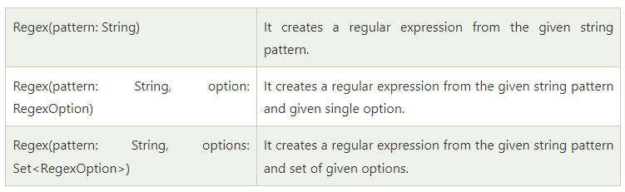

Slide 29
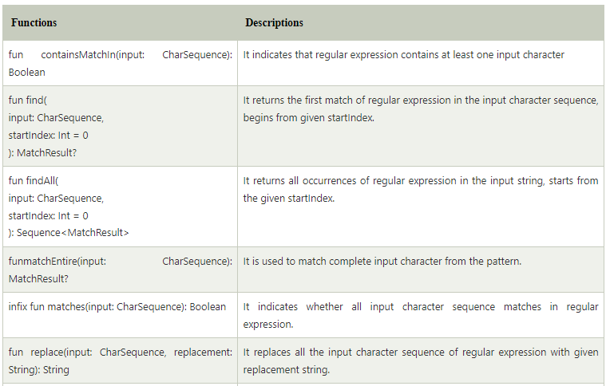

Slide 30
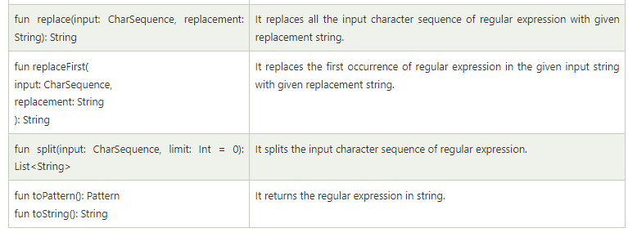

Slide 31
Example of Regex class checking contains of input pattern
fun main(args: Array<String>){
val regex = Regex(pattern = "ko")
val matched = regex.containsMatchIn(input = "kotlin")
println(matched)
}

Slide 32
fun main(args: Array<String>){
val regex = """a([bc]+)d?""".toRegex()
val matched = regex.containsMatchIn(input = "xabcdy")
println(matched)
}

Slide 33
fun main(args: Array<String>){
val regex = """a([bc]+)d?""".toRegex()
val matched1 = regex.matches(input = "xabcdy")
val matched2 = regex.matches(input = "xabcdyabcd")
val matched3 = regex.matches(input = "abcd")
println(matched1)
println(matched2)
println(matched3)
}

Slide 34
fun main(args: Array<String>){
val regex = Regex("abcd")
val matchResult1 = regex.matchEntire("abcd")?.value
val matchResult2 = regex.matchEntire("abcda")?.value
val matchResult3 = Regex("""\d+""").matchEntire("100")?.value
val matchResult4 = Regex("""\d+""").matchEntire("100 dollars")?.value
println(matchResult1)
println(matchResult2)
println(matchResult3)
println(matchResult4)
}

Slide 35
fun main(args: Array<String>){
val emailParttern = Regex("""\w+@[a-zA-Z_]+?\.[a-zA-Z]{2,6}""")
val email :String? = emailParttern.find("this is my email mymail@google.com")?.value
println(email)
val phoneNumber :String? = Regex(pattern = """\d{3}-\d{3}-\d{4}""")
.find("phone: 123-456-7890, e..")?.value
println(phoneNumber)
}

Slide 36
fun main(args: Array<String>){
val foundResults = Regex("""\d+""").findAll("ab12cd34ef 56gh7 8i")
val result = StringBuilder()
for (findText in foundResults) {
result.append(findText.value + " ")
}
println(result)
}

Slide 37
fun main(args: Array<String>){
val replaceWith = Regex("beautiful")
val resultString = replaceWith.replace("this picture is beautiful","awesome")
println(resultString)
}

Slide 38
fun main(args: Array<String>){
val replaceWith = Regex("beautiful")
val resultString = replaceWith.replaceFirst("nature is beautiful, beautiful is nature","awesome")
println(resultString)
}

Slide 39
open class Employee(name: String, age: Int, salary: Float) {
init {
println("Name is $name.")
println("Age is $age")
println("Salary is $salary")
}
}
class Programmer(name: String, age: Int, salary: Float):Employee(name,age,salary){
fun doProgram() {
println("programming is my passion.")
}
}
class Salesman(name: String, age: Int, salary: Float):Employee(name,age,salary){
fun fieldWork() {
println("travelling is my hobby.")
}
}
fun main(args: Array<String>){
val obj1 = Programmer("Ashu", 25, 40000f)
obj1.doProgram()
val obj2 = Salesman("Ajay", 24, 30000f)
obj2.fieldWork()
}

